Slide 1
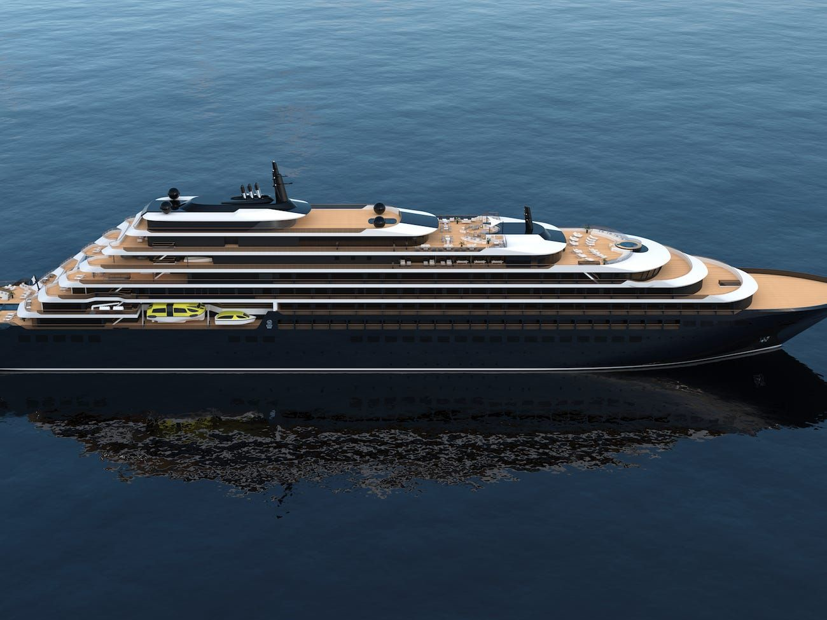
WELCOME

Slide 2

CRUISE SHIP BOOKING SYSTEM

Slide 3
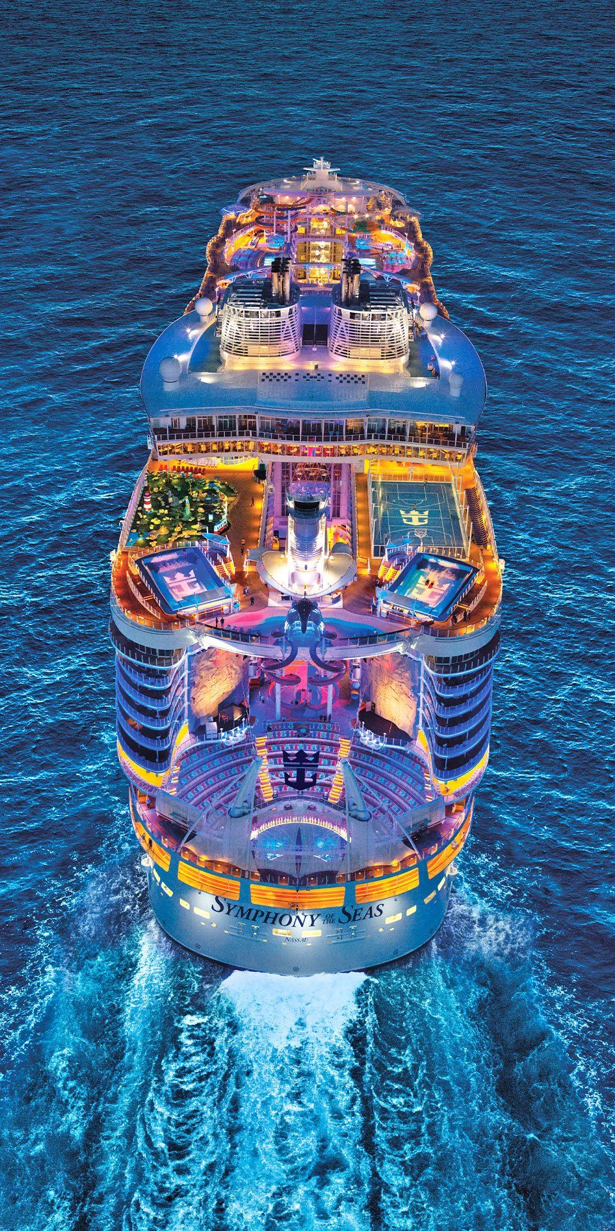
SYNOPSIS
A Cruise Vacation Offers Great Value.
See Multiple Destinations, Unpack Only Once.
Cruise Ships are Family Friendly.
Cruise Ships Come in All Shapes and Sizes.
Ships Offer a Variety of Onboard Activities.
Cruise Vacations are Easy to Plan.
Ships Are Floating Cities.
Plan an Exotic Vacation

Slide 4

INTRODUCTION
This project is to manage the booking system for luxury travel cruise ship. The tour operator can provide various tour plans and packages. Customers can book those by viewing the facilities provided like - Cruise name , ports touching, destination. departure date, arrival date, Rate of the package etc. Customers have the option to book packages, by checking the available dates which customers prefer. Customers have the option to cancel the packages if there is any inconvenience. Registration option for the customers, Operators is available. All the packages can be viewed by the customers. Operator can add new packages and rates based on his business. This project is developed using Node JS and MySQL.

Slide 5
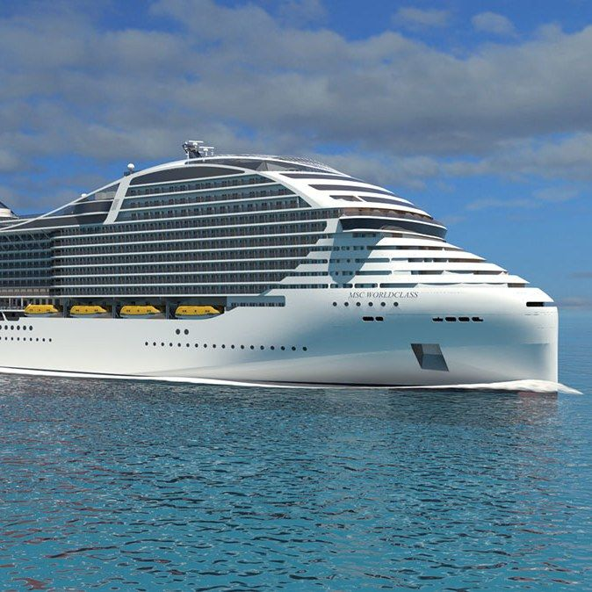
OBJECTIVE
This project aims at developing a user-friendly web application. It is an efficient, time saving, secure and easy way to get information about packages and user can simply book packages.
The main objective of the system is that all the process was made online.
Booking packages in Cruise ship is made possible through the new system.
All necessary details needed for a journey are made available to the passengers. For example, ship schedule, ship location, rate details etc.
Since all payments are made online ,Also reduced the effort of tour operator, they just need to verify the booked tickets no need to deal with payments.
E-booking made paperless ticket traveling experience, because we don’t need to worry about tear wear or loss of ship tickets.

Slide 6
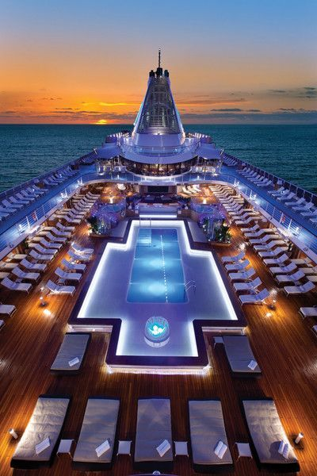
EXISTING SYSTEM
During the analysis phase the existing system was studied, currently the existing system is fully manual and not efficient, and difficult for a good travelling experience.
Drawbacks of Existing System
In the existing system doesn’t have the facilities for book packages with user convenience.
In the existing system there is no proper way to get the details of ship between port and destination.
In the existing system there is no option to pay by means of available online payment methods.

Slide 7

PROPOSED SYSTEM
CRUISE SHIP BOOKING SYSTEM is Web application which overcome all the drawbacks of existing system and provides an efficient and responsive application for getting the details about Cruise ship , packages and book packages . Proposed system consists of mainly three modules, they are:
Admin
Tour Operator
User
Advantages of proposed system
By replacing all the manual processes, the proposed system is fully online process.
The proposed system provides a facility to book luxury Cruise ships easily.
It is a user friendly website.
Users can simply view the packages by checking the available dates which customers prefer and can cancel the packages if there is any inconvenience.
Operator can add new packages and rates based on his business.

Slide 8
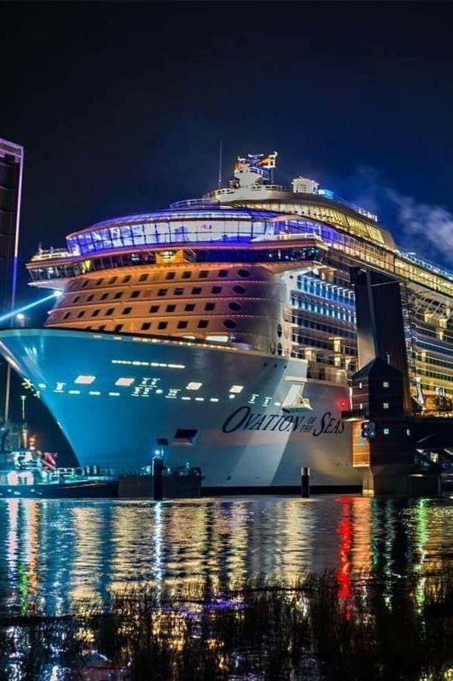
FRONT END
HTML The HyperText Markup Language, or HTML is the standard markup language for documents designed to be displayed in a web browser. It can be assisted by technologies such as Cascading Style Sheets (CSS) and scripting languages such as JavaScript. Web browsers receive HTML documents from a web server or from local storage and render the documents into multimedia web pages. HTML describes the structure of a webpage semantically and originally included cues for the appearance of the document. HTML elements are the building blocks of HTML pages. With HTML constructs, images and other objects such as interactive forms may be embedded into the rendered page. HTML can embed programs written in a scripting language such as JavaScript, which affects the behavior and content of web pages. Inclusion of CSS defines the look and layout of content. The World Wide Web Consortium (W3C), former maintainer of the HTML and current maintainer of the CSS standards, has encouraged the use of CSS over explicit presentational HTML since 1997. A form of HTML, known as HTML5, is used to display video and audio, primarily using the element, in collaboration with javascript
NODE JS
Node js is an open-source, cross-platform, back-end JavaScript runtime environment that runs on the V8 engine and executes JavaScript code outside a web browser. Node.js lets developers use JavaScript to write command line tools and for server-side scripting—running scripts server-side to produce dynamic web page content before the page is sent to the user's web browser. Consequently, Node.js represents a "JavaScript everywhere" paradigm, unifying web-application development around a single programming language, rather than different languages for server-side and client-side scripts. Though .js is the standard filename extension for JavaScript code, the name "Node.js" does not refer to a particular file in this context and is merely the name of the product. Node.js has an event-driven architecture capable of asynchronous I/O. These design choices aim to optimize throughput and scalability in web applications with many input/output operations, as well as for real-time Web applications (e.g., real-time communication programs and browser games). The Node.js distributed development project was previously governed by the Node.js Foundation, and has now merged with the JS Foundation to form the OpenJS Foundation, which is facilitated by the Linux Foundation's Collaborative Projects program.

Slide 9
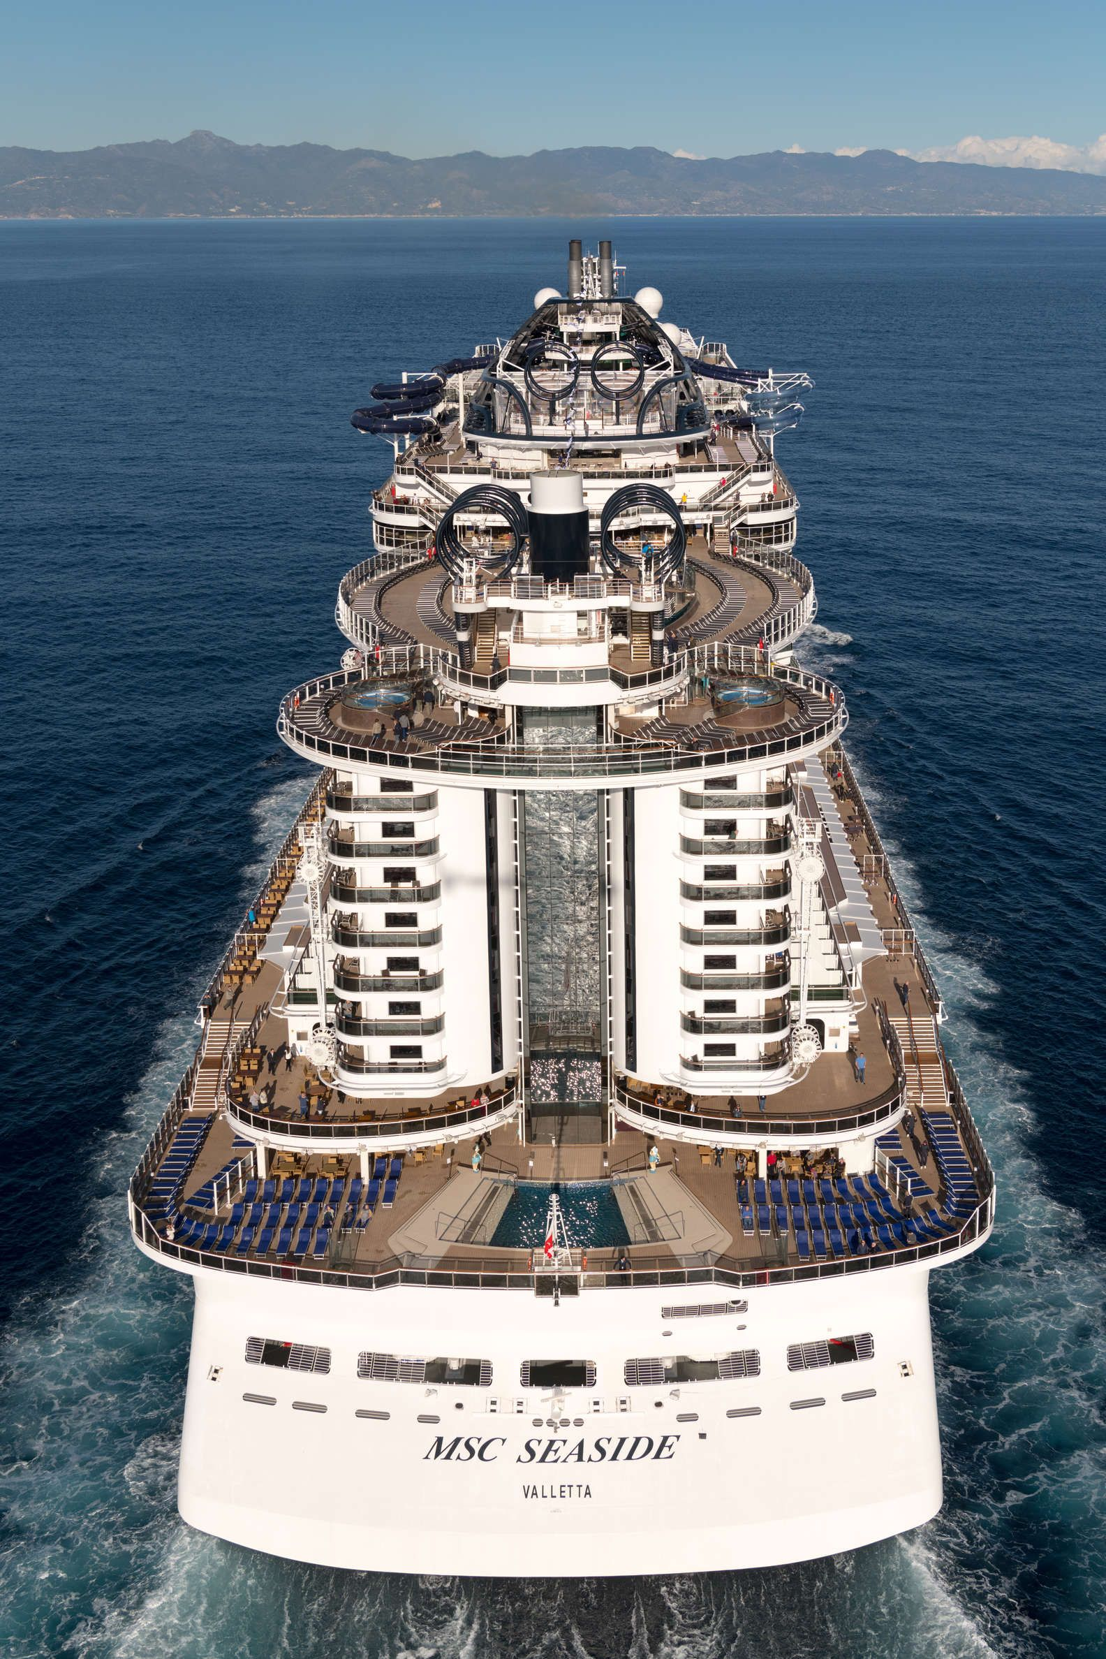
Back end
MySQL
MySQL is an Oracle-backed open source relational database management system (RDBMS) based on Structured Query Language (SQL). MySQL runs on virtually all platforms, including Linux, UNIX and Windows. Although it can be used in a wide range of applications, MySQL database has become the world's most popular Open source database because of its consistency, fast performance, high reliability and ease of use. MySQL is basedon a client- server model. The core of MySQL is MySQL server, which handles all of the database instructions (or commands).
Originally conceived by the Swedish company MySQL AB, MySQL was acquired by Sun Microsystems in 2008 and then by Oracle when it bought Sun in 2010. Developers can use MySQL under the GNU General Public License (GPL), but enterprises must obtain a commercial license from Oracle. Today, MySQL is the RDBMS behind many of the top websites in the world and countless corporate and consumer-facing web-based applications, including Facebook, Twitter and YouTube.

Slide 10

SYSTEM FLOW

Slide 11
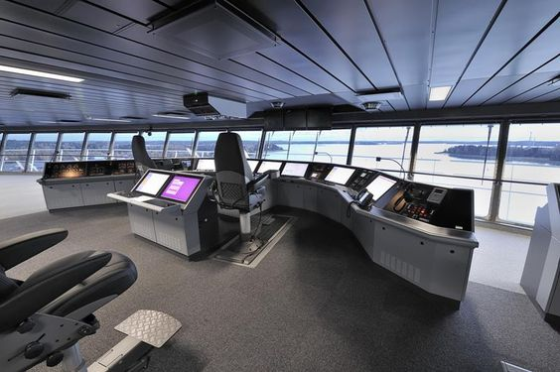
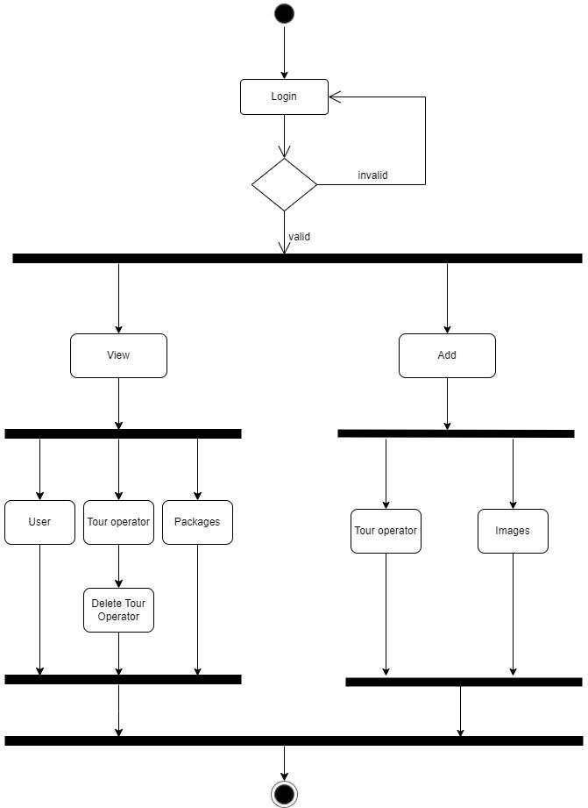
ADMIN
Admin manages the system, all activities in the system is controlled by admin.
❖ Login
❖ Add Tour Operators
❖ Delete Tour Operators
❖ Add Images
❖ View Tour Operators
❖ View Registered Users
❖ View Packages

Slide 12
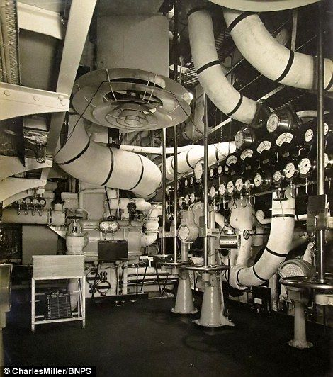
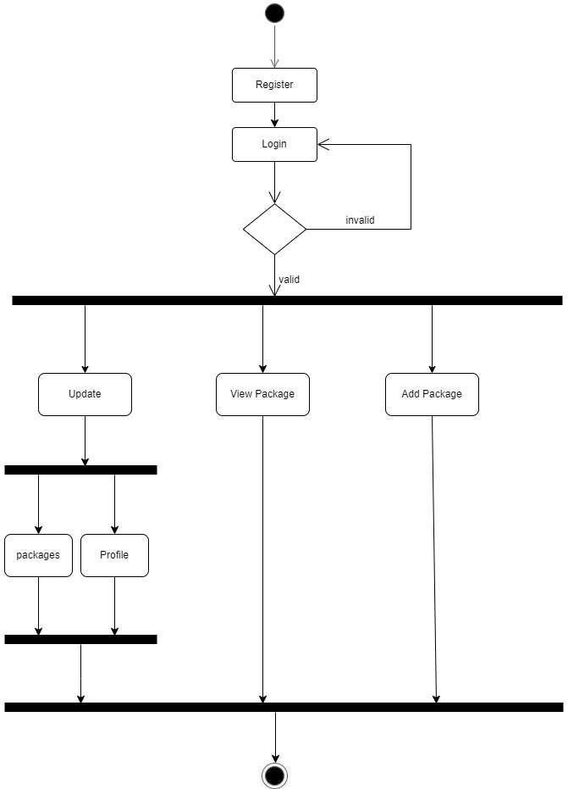
TOUR OPERATOR
TOUR OPERATOR
❖ Login
❖ Add Packages
❖ View Packages
❖ Update Packages
❖ Update Profile

Slide 13

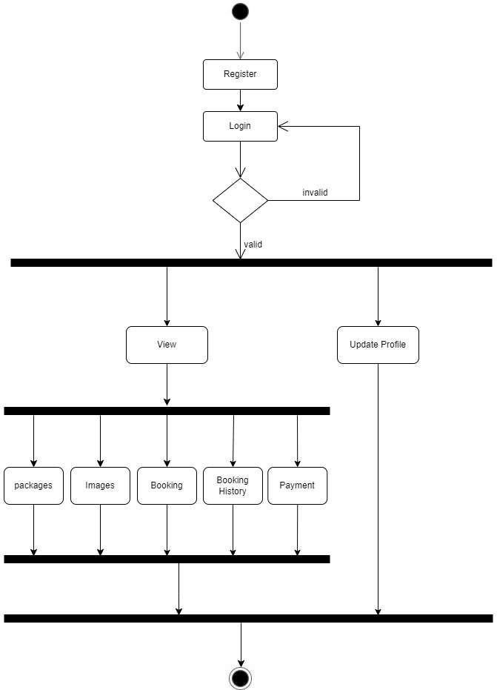
USER
USER
❖ Register
❖ Login
❖ Update Profile
❖ View Packages
❖ View Images
❖ Book Packages
❖ Payment
❖ View Booking history

Slide 14

SCREENSHOT

Slide 15
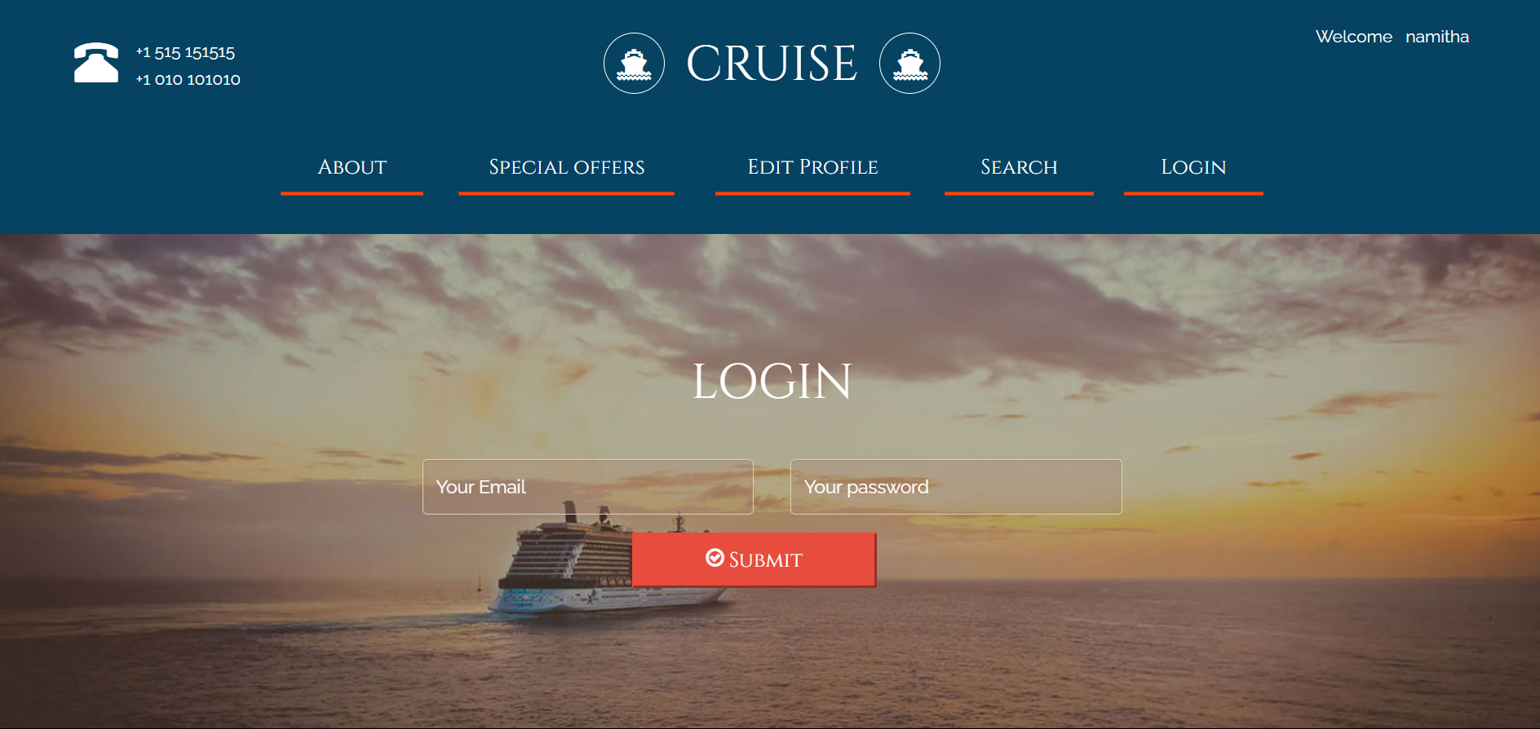
LOGIN

Slide 16
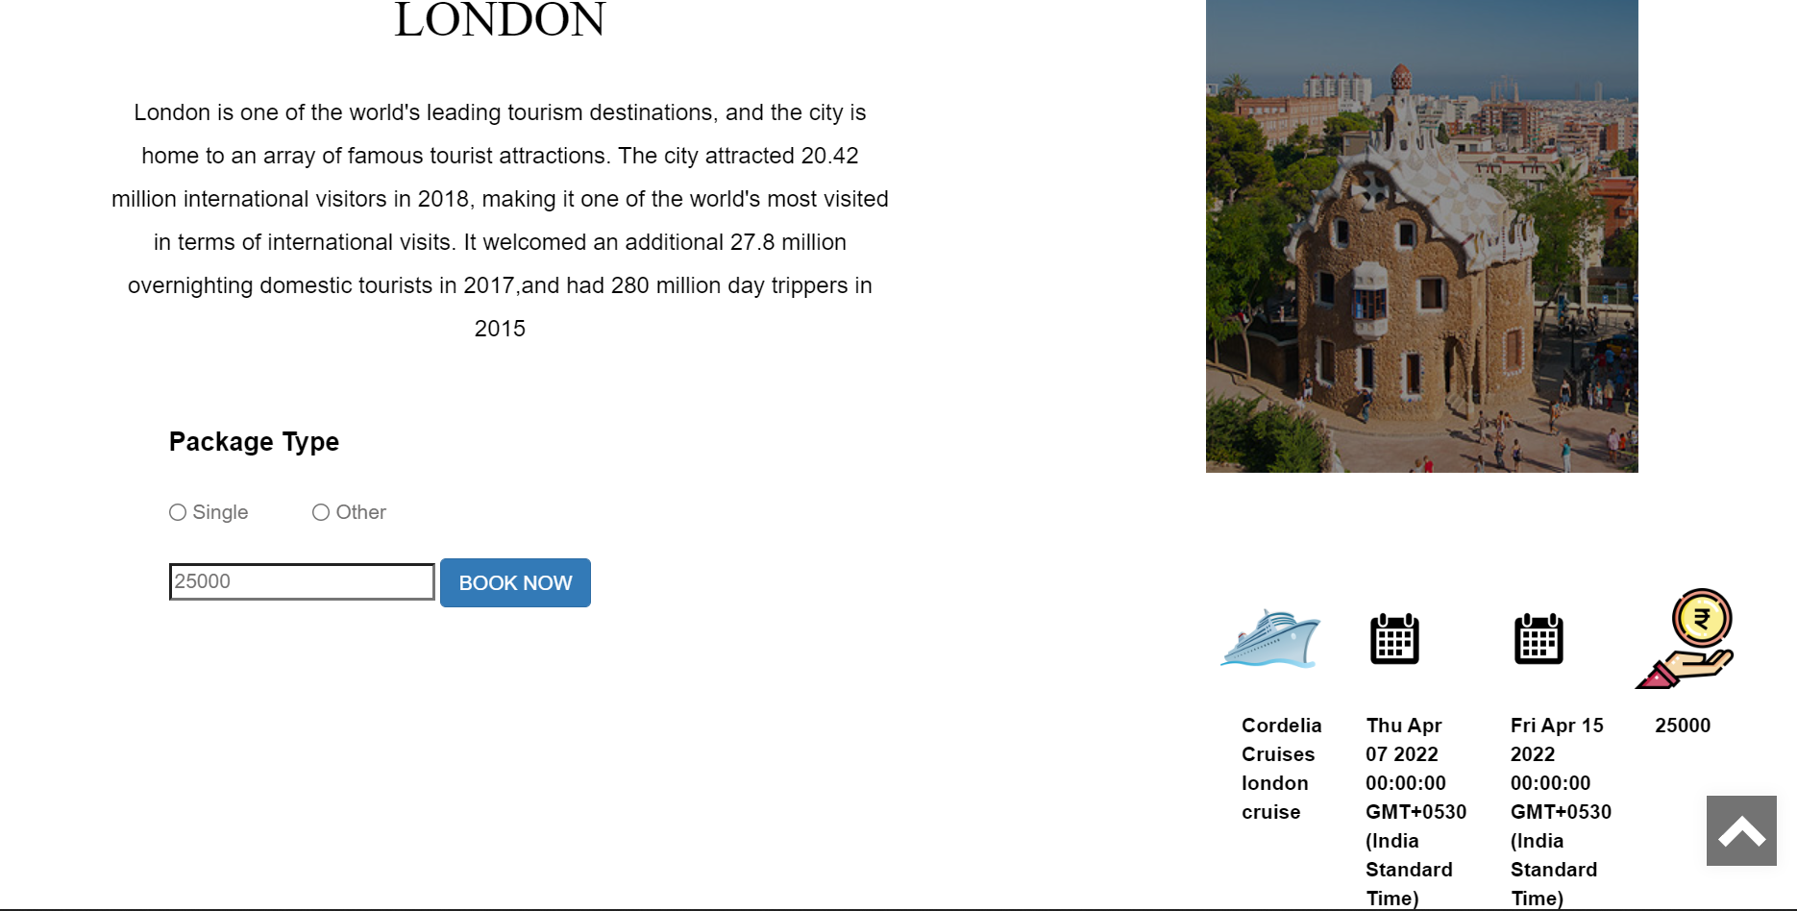
USER PACKAGE

Slide 17
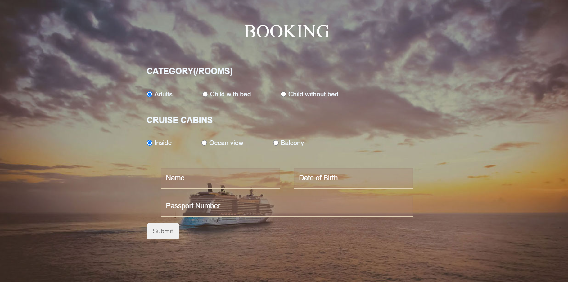
PACKAGE BOOKING

Slide 18
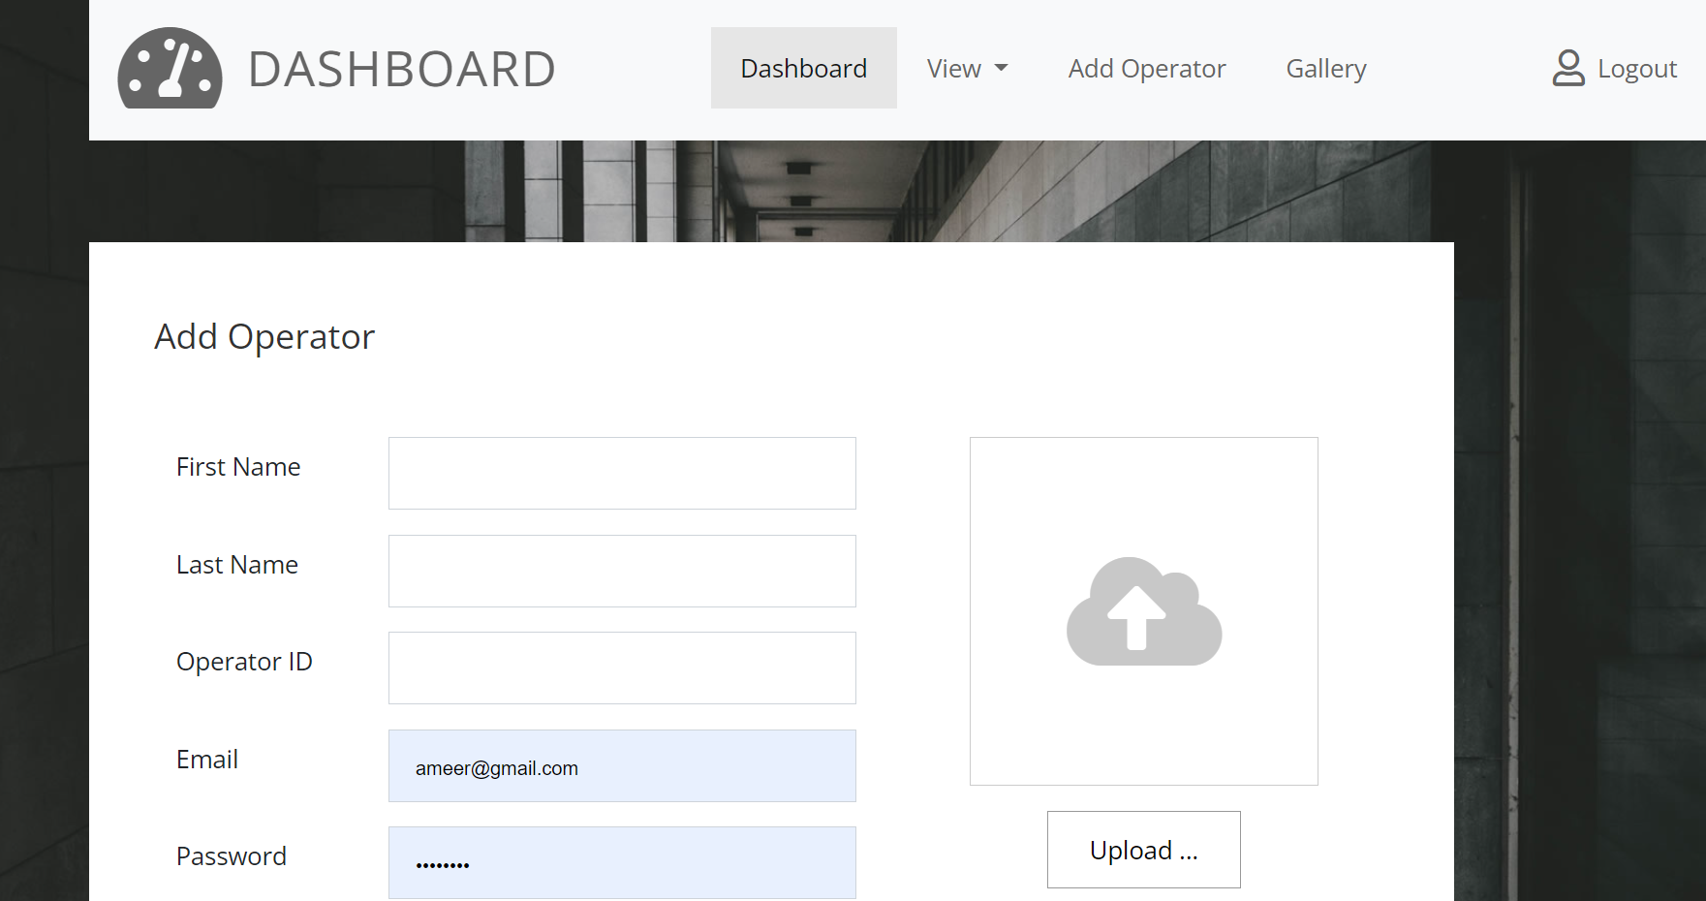
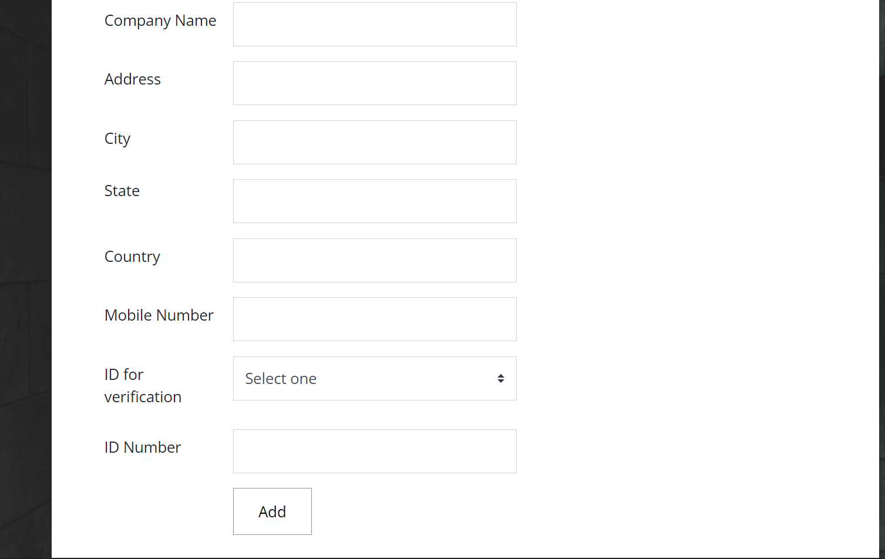
ADMIN ADD OPERATOR

Slide 19

TOUR OPERATOR ADD PACKAGES

Slide 20
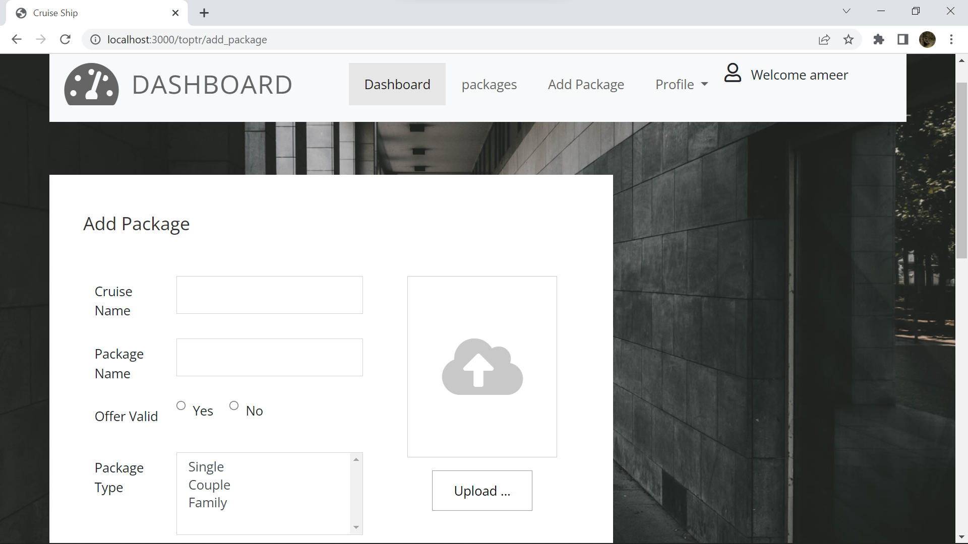
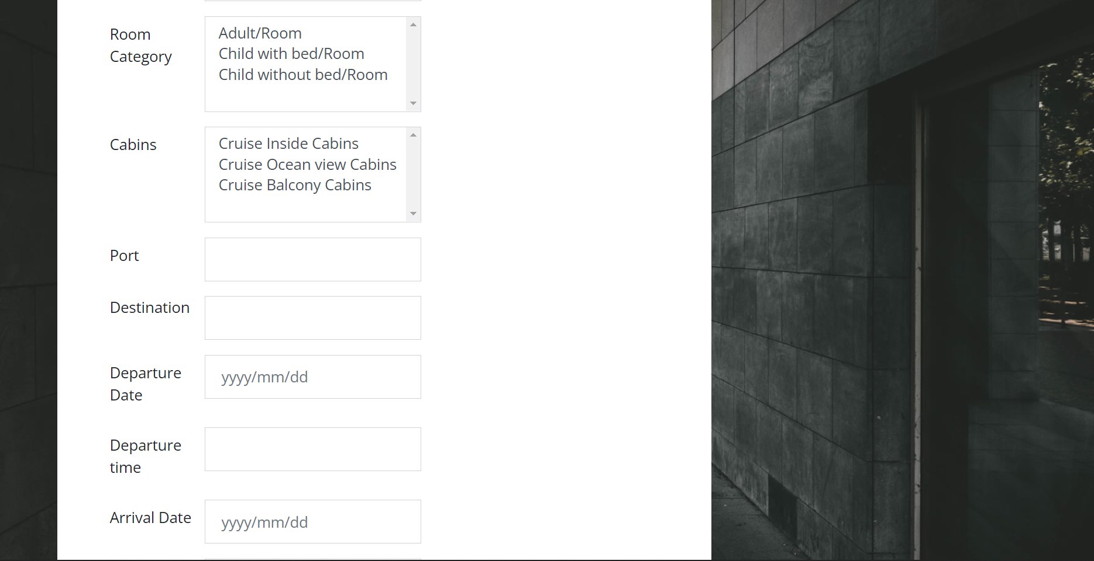
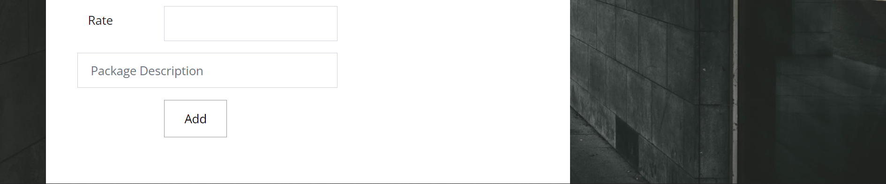

Slide 21

CONCLUSION

Slide 22
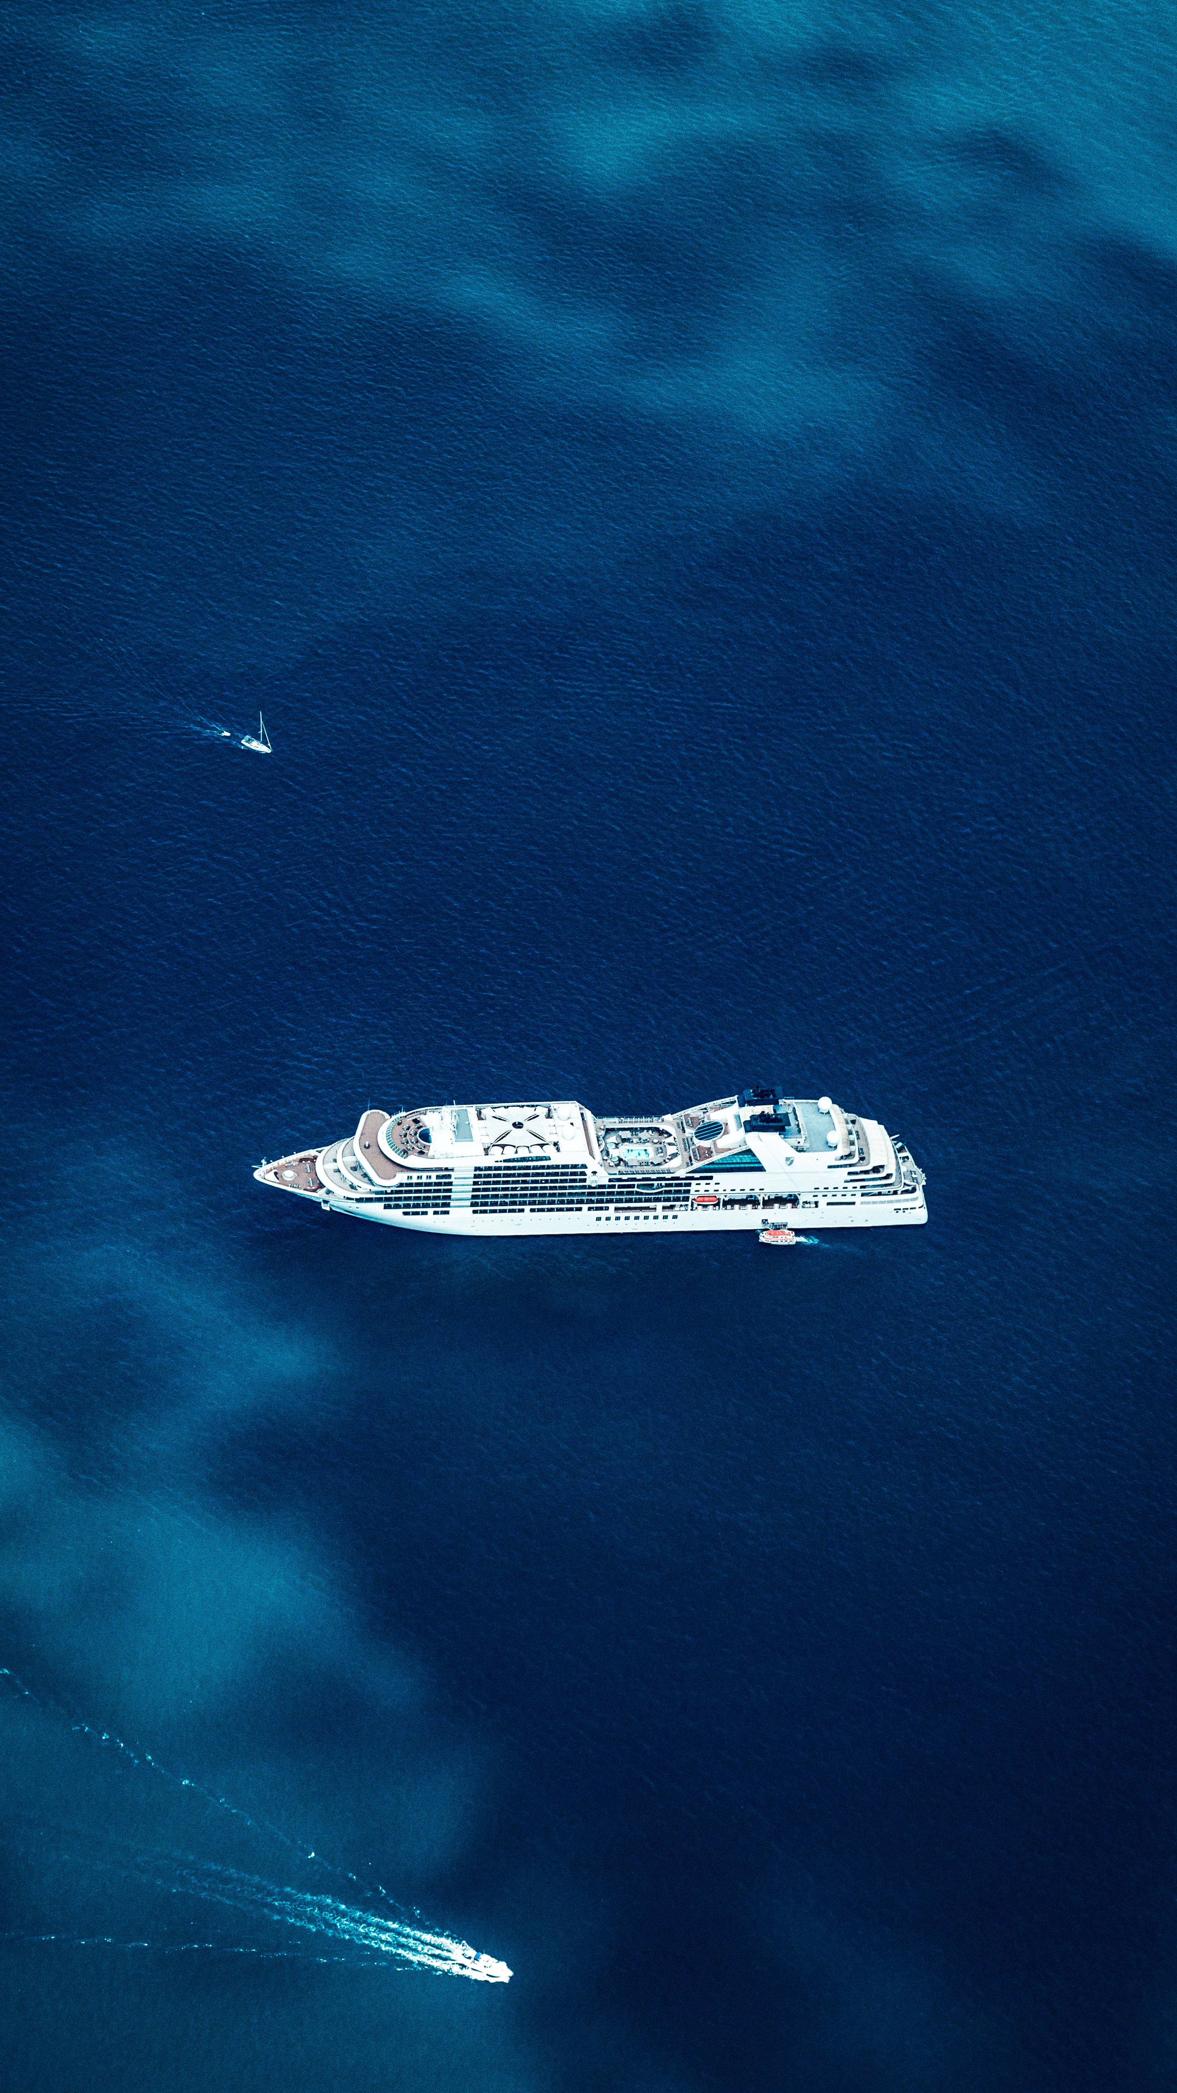
CONCLUSION
CRUISE SHIP BOOKING SYSTEM is an initiative towards enhancing the users experience in availing Ship services for package booking in all over the world. The proposed web application provides complete details about cruise ship and available packages. With the help of CRUISE SHIP BOOKING SYSTEM, tour operator work load can be reduced. Also, day to day transactions can be easily accessible. All the knowledge I gained is fully applied in the design of the mentioned system. All the suggestions forwarded in the software proposal have been completed. This system is developed in such a way that the modules developed in the future can be linked easily to the system, without affecting the existing system, since it provides a hierarchical structure. Top down programming approach has been adopted while developing the project; each task is divided separate modules. Hence the modification and enhancement can be easily made without affecting any other part of the program. This system has been developed to satisfy the user needs. The entire system is user friendly. The performance of the system is provided efficiently. The system was tested with all possible test data and was found to have an affective planning of the functions or processes with a high degree of accuracy and user friendliness.

